Slide 1
Parallel and Distributed Computing
Models of Parallel Computers and Interconnection

Slide 2
Today We Will learn,
Architecture of Theoretical Parallel Computer (PRAM)
PRAM Subclasses
PRAM Semantics
Interconnection Networks
Network Topologies

Slide 3
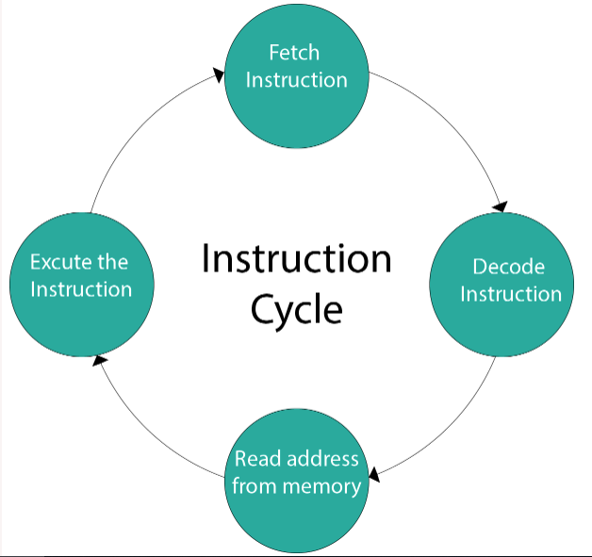
Instruction Cycle
A program residing in the memory unit of a computer consists of a sequence of instructions.
These instructions are executed by the processor
by going through a cycle for each instruction
Also known as the fetch–decode–execute cycle,
or simply the fetch-execute cycle

Slide 4
Clock Cycle
A clock cycle is also known as a clock tick
It is a single increment of the central processing unit (CPU) clock during which the smallest unit of processor activity is carried out.
It helps in determining the speed of the CPU, as it is considered the basic unit of measuring how fast an instruction can be executed by the computer processor
The clock speed of a processor is measured in hertz, which is clock cycles per second.
A CPU which completes three billion clock cycles per second has a clock speed of 3 GHz.

Slide 5
Concurrent Process
Concurrent means something that happens at the same time
Concurrent processing is a computing model in which multiple processors execute instructions simultaneously for better performance
Concurrent processing is sometimes said to be synonymous with parallel processing.
The tasks are broken into sub-types, which are then assigned to different processors to perform simultaneously, sequentially instead, as they would have to be performed by one processor

Slide 6
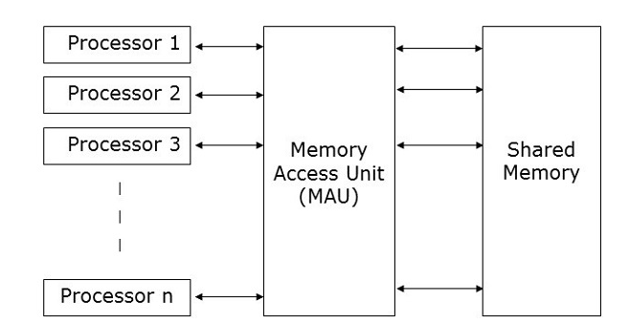
Architecture of Theoretical Parallel Computer
Parallel Random Access Machine (PRAM) is a theoretical model of parallel computer, with
p identical processors
a global memory of unbounded size
memory is uniformly accessible to all processors

Slide 7
Architecture of Theoretical Parallel Computer
In PRAM, Processors share a common clock
They may execute different instructions in each cycle
There are many methods to implement the PRAM model, but the most prominent ones are −
Shared memory model
Message passing model
Data parallel model

Slide 8
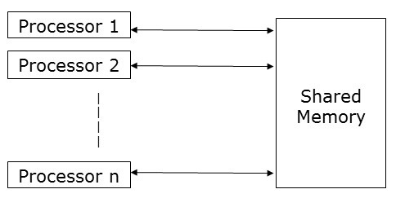
Architecture of Theoretical Parallel Computer
Shared memory model

Slide 9
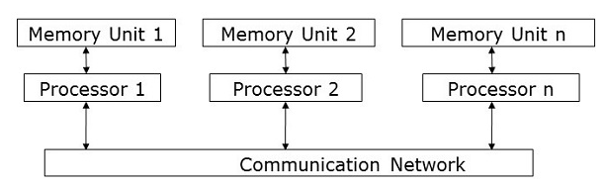
Architecture of Theoretical Parallel Computer
Message passing model

Slide 10
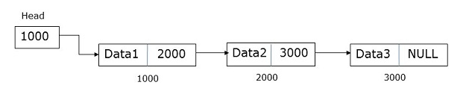
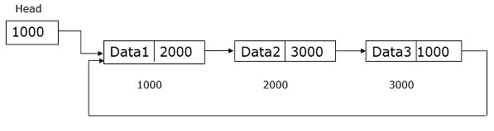
Architecture of Theoretical Parallel Computer
Data parallel model
The major focus of data parallel programming model is on performing operations on a data set simultaneously.
The data set is organized into some structure like an array, hypercube, etc.
Processors perform operations collectively on the same data structure.
Each task is performed on a different partition of the same data structure

Slide 11
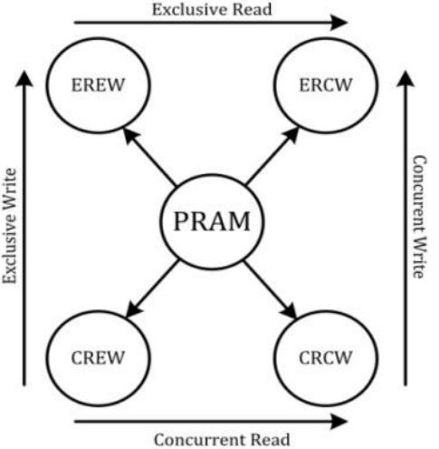
PRAM Subclasses
There are four subclasses of PRAM, based on the memory access protocols

Slide 12
PRAM Subclasses
Exclusive-read, exclusive-write (EREW) PRAM
Access to a memory location is exclusive.
No concurrent read or write operations are allowed
The weakest PRAM model, affording minimum concurrency in memory access
Concurrent-read, exclusive-write (CREW) PRAM
Multiple read accesses to a memory location is allowed.
Multiple write accesses to a memory location is serialized

Slide 13
PRAM Subclasses
Exclusive-read, concurrent-write (ERCW) PRAM
Multiple write accesses are allowed to a memory location.
Multiple read accesses are serialized
Concurrent-read, concurrent-write (CRCW) PRAM
Both multiple read and multiple write accesses to a memory location are allowed
This is the most powerful PRAM model

Slide 14
PRAM Semantics
Concurrent read access to a memory location by all processors is OK.
Concurrent write access to a memory location presents semantic discrepancy and requires arbitration
The most frequently used arbitration protocols are:
Common: Concurrent write is allowed if all the writing processors have the same value
Arbitrary: An arbitrary processor is allowed to proceed with the write operation, and the rest fail

Slide 15
PRAM Semantics
Priority: Processors are prioritized a priori, the processor with the highest priority writes and others fail
Sum: The sum of all the quantities is written

Slide 16
Processor Granularity
In parallel computing, granularity (or grain size) of a task is a measure of the amount of work (or computation) which is performed by that task
Granularity is usually measured in terms of the number of instructions executed in a particular task.
Alternately, granularity can also be specified in terms of the execution time of a program, combining the computation time and communication time.

Slide 17
Processor Granularity
In parallel computing, Processor granularity sometimes refers to the power of individual processor.
It is also used to denote the degree of parallelism.
Coarse-grained: Few powerful processors
Fine-grained: Many, less powerful processors
Medium-grained: between the above two

Slide 18
Processor Granularity
Another definition of granularity is with respect to the relative rates of communication to computation
Fine-grained: shorter duration between communication
Coarse-grained: longer duration between communication

Slide 19
Interconnection Networks
Static networks: Processing nodes are connected by point-to-point communication
links (direct networks). Mostly used for message-passing computers
Dynamic networks: Communication links are connected to one another dynamically by the switches to establish paths among processing nodes and memory banks (indirect networks)
Mostly used for shared memory computers

Slide 20
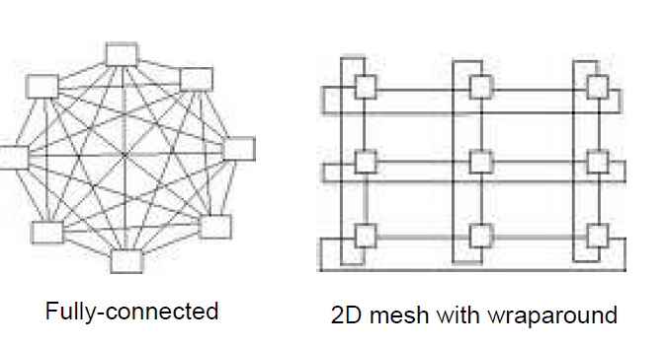
Interconnection Networks
Examples of Static networks

Slide 21
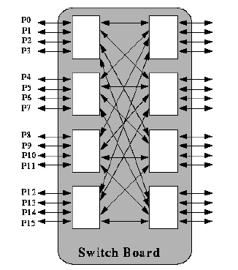
Interconnection Networks
Switch based Connections

Slide 22
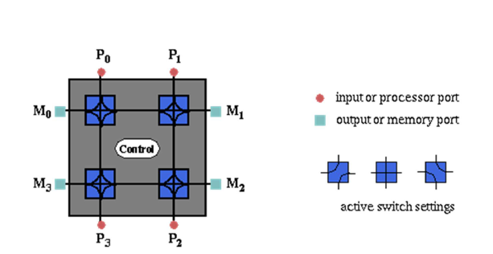
Interconnection Networks
Dynamic Interactions

Slide 23
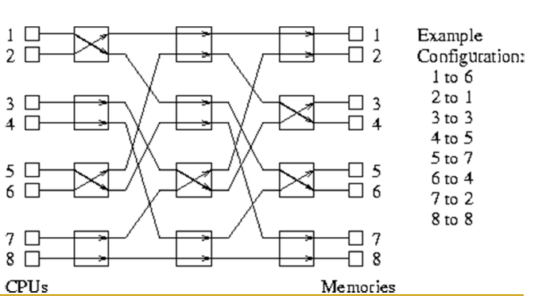
Interconnection Networks
Multistage Dynamic Interactions

Slide 24
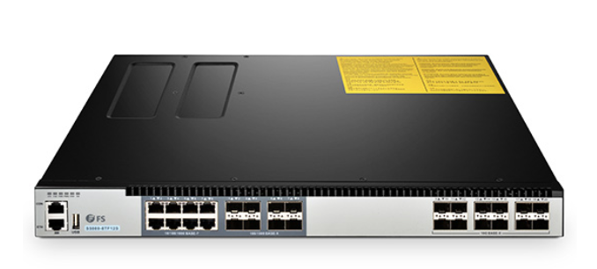
Switch Functionalities & Cost
A switch is a hardware device that filters and forwards network packets from one networking device (switch, router, computer, server, etc.) to another.
A single switch has a set of input ports and a set of output ports

Slide 25
Switch Functionalities & Cost
The switch functionalities include:
a mapping from input to output ports (basic)
additional support for internal buffering (when the requested output port is busy), routing (to alleviate network congestion), and multicasting (same output on multiple ports)
The degree of a switch is the total number of ports
The cost of a switch is influenced by the cost of mapping hardware, the peripheral hardware, and packaging costs

Slide 26
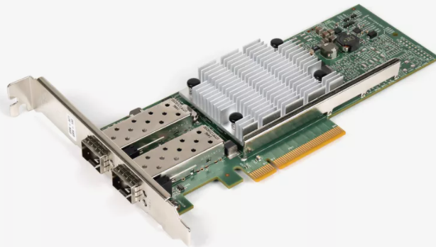
Network Interface
Network interface is to handle the connectivity between the node and the network
A network interface is generally a network interface card (NIC)
Network interface has input and output ports that pipe data into and out of the network
Its functionalities include:
packetizing data
computing routing information
buffering incoming and outgoing data
error checking

Slide 27
Network Interface
Network interface is to handle the connectivity between the node and the network
Network interface has input and output ports that pipe data into and out of the network
Its functionalities include:
packetizing data
computing routing information
buffering incoming and outgoing data
error checking
For dynamic interconnection networks: Its cost is proportional to the number of switches used in the network
For static Interconnection networks: Its cost is proportional to the number of links

Slide 28
Network Topologies
Multiple processors must be working together to solve a common task
They must communicate during the course of solving the task problems
The communication is provided by the interconnection networks
How to connect multiple processors in a parallel system -This is a trade-off between cost and scalability with performance

Slide 29
Bus Based Network
A bus-based network consists of a shared medium that connects all nodes
The cost of a bus-based network scales linearly with respect to the number of processors p
The distance between any two nodes in the network is constant O(1)
Ideal for broadcasting information
Disadvantage: bounded bandwidth & blocking Performance is not scalable with respect to the number of processors p

Slide 30
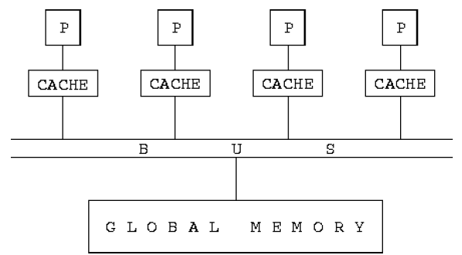
Bus Based Network

Slide 31
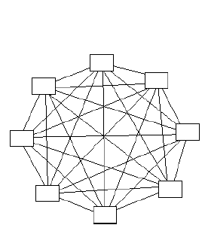
Completely Connect Network
Each node has a direct communication link to every other node in the network (non-blocking)
How many communication links are needed?
Scalable in terms of performance, not scalable in terms of cost

Slide 32
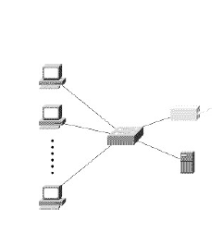
Star Connect Network
One processor acts as the central processor
Every other processor has a communication link with this processor
Congestion may happen at the central processor
This is a blocking network
Scalable in terms of cost, not scalable in terms of performance

Slide 33
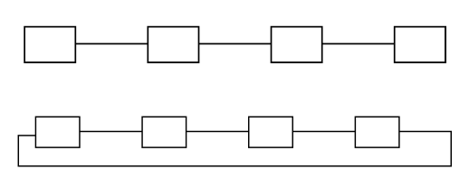
Linear Array and Ring Networks
Scalable in terms of costs, not scalable in terms of performance

Slide 34
Crossbar Network
A crossbar network uses a grid of switches or switching nodes to connect p processors to b memory banks
It is a non-blocking network
The total number of switching nodes is Θ(pb)
In many cases, b is at least on the order of p, the complexity of the crossbar network is Ω(p*p)
Disadvantage: Switch complexity is difficult to realize at high data rates
Scalable in terms of performance, but not scalable in terms of cost

Slide 35
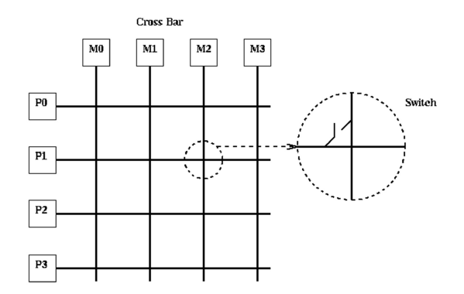
Crossbar Network

Slide 36
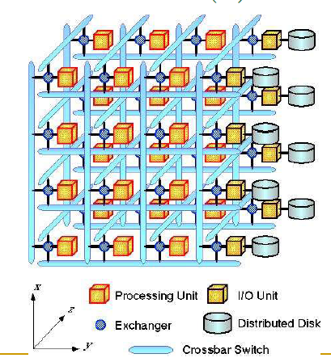
Crossbar Network

Slide 37
Multistage Network
To balance the scalability between performance and costs
Allowing multiple stages between processors and memory banks
Switches are installed at each stage
It is more scalable than bus-based networks in terms of performance
It is more scalable than the crossbar networks in terms of costs
A special multistage interconnection network is the omega network

Slide 38
Multistage Network
Multistage Interactions

Slide 39
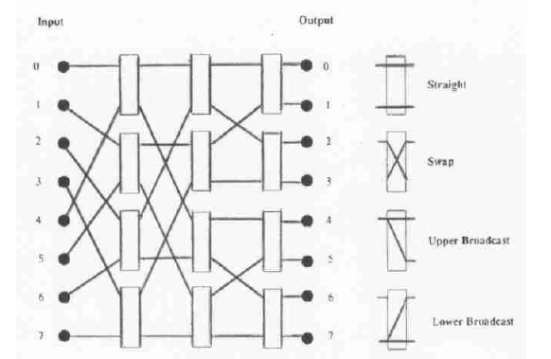
Multistage Network
Multistage Interactions

Slide 40
Assignment - Only Hand-Written Accepted

